Slide 1
DATA STRUCTURE AND ALGORTHMS
PROJECT
PRESENTATION

Slide 2
BUS RESERVATION SYSTEM

Slide 3
TEAM MEMBERS
CB.SC.U4CSE23413-DUGGINENI AKHIL
CB.SC.U4CSE23414-E.RATAN RAJA
CB.SC.U4CSE23419-K.VARSHITH
CB.SC.U4CSE23421-K-YOKSHITH

Slide 4
PROJECT OVERVIEW
A bus reservation system that allows users to view, search, and reserve seats on buses.
Features: 1. Display All Buses
2. Search for Buses
3. Reserve a Seat
4. Confirm Ticket
5. Show Express Buses
6. Cancel Ticket
7. Exit

Slide 5
DATA STRUCTURES USED
Linked List:
Why: Allows flexible storage and easy traversal of buses.
How: Each BusNode contains a bus and a reference to the next node.
Stack:
Why: Tracks recently reserved buses for efficient last-in, first-out access.
How: Each bus reserved is pushed to a stack, making recent bookings easy to access.
Queue:
Why: Manages waiting passengers when buses are full, supporting first-come, first-served order.
How: Passengers in line are stored in a queue; dequeued when seats are available.

Slide 6
CLASS STRUCTURES
BusLinkedList : Stores all buses as a linked list for easy addition, deletion, and traversal.
BusNode : Each node stores a bus object.
BusClass :
Attributes: Contains bus-specific information like number, driver, route, fare, and date.
Functions : reserve_seat(): Handles seat selection and reservation.
display_seats(): Displays current seat availability
BusReservationSystem:
Manages all main functionalities, including predefined buses, search, reservation, and ticket confirmation.

Slide 7
KEY FUNCTIONALITIES
Display All Buses:
Shows a list of all available buses, their routes, timings, fare, and whether they’re express.
Search Buses:
Allows users to search for buses based on boarding location, destination, and travel date.
Reserve a Seat:
Enables users to book seats by entering passenger details and generates a unique PIN for ticket confirmation.
Confirm Ticket:
Confirms bookings once payment is made, using the generated PIN for verification.
Cancel Ticket:
Cancels reservations by PIN, updates seat status to available.

Slide 8
ADVANCED FUNCTIONALITIES
Express Buses:
Certain buses are marked as express for faster travel. Users can filter to view only express options.
Waiting Queue:
If the bus is fully booked, passengers are placed in a queue (not yet implemented but planned).
Seat Map Management:
32 seats arranged in an 8x4 grid are managed for each bus, tracking available and reserved seats.

Slide 9
CODE HIGHLIGHTS
BusReservationSystem:
Predefined_buses(): Initializes buses with a weekly schedule, assigning random drivers and timings.
Generate_pin(): Generates a 4-digit PIN for secure reservation tracking.
Additional Note: Bus objects are dynamically added to BusLinkedList, simulating real-world scalability.
Seat Reservation:
Checks seat availability and stores passenger info with a confirmation PIN.
Display: Seats displayed as “Empty” or “Confirmed” for easy selection by users.

Slide 10
CONCLUSION
Summary:
Successfully implemented a functional bus reservation system using Linked List, Stack, and Queue.
Provides full reservation capabilities, including search, booking, confirmation, and cancellation.

Slide 11
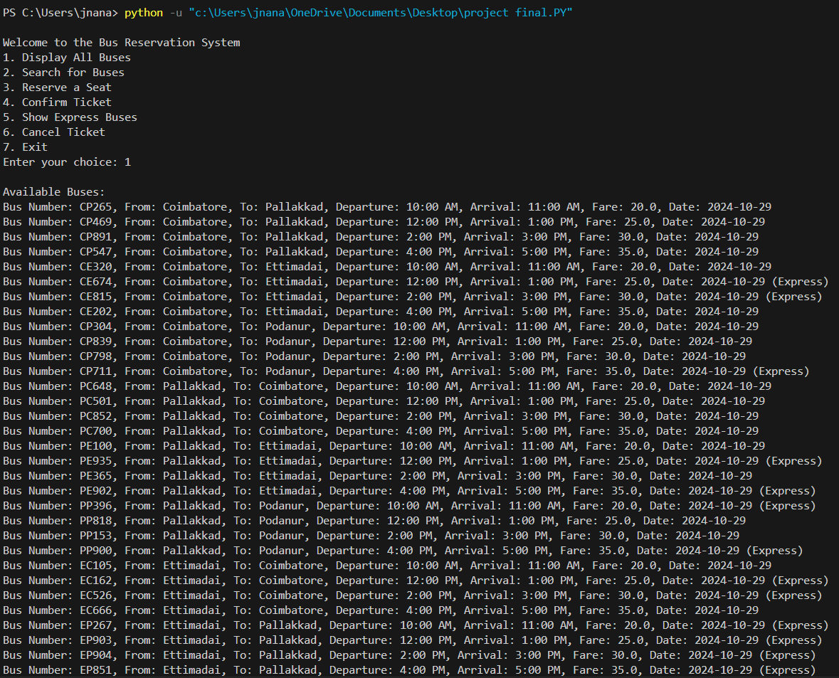
TEST CASE-1

Slide 12
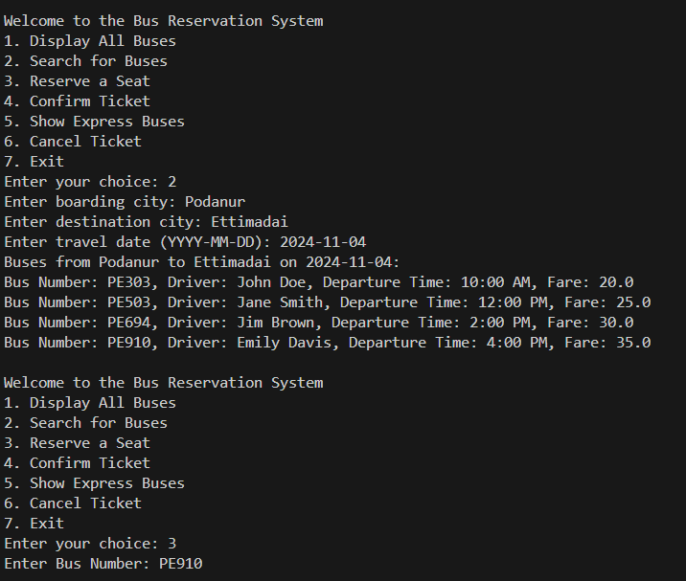

Slide 13
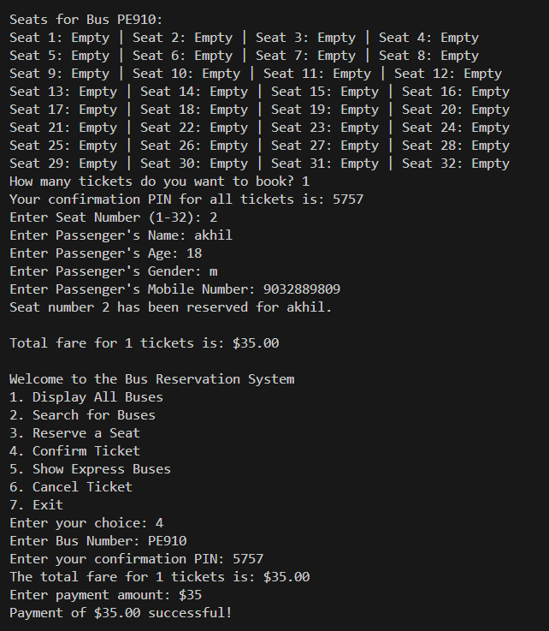

Slide 14
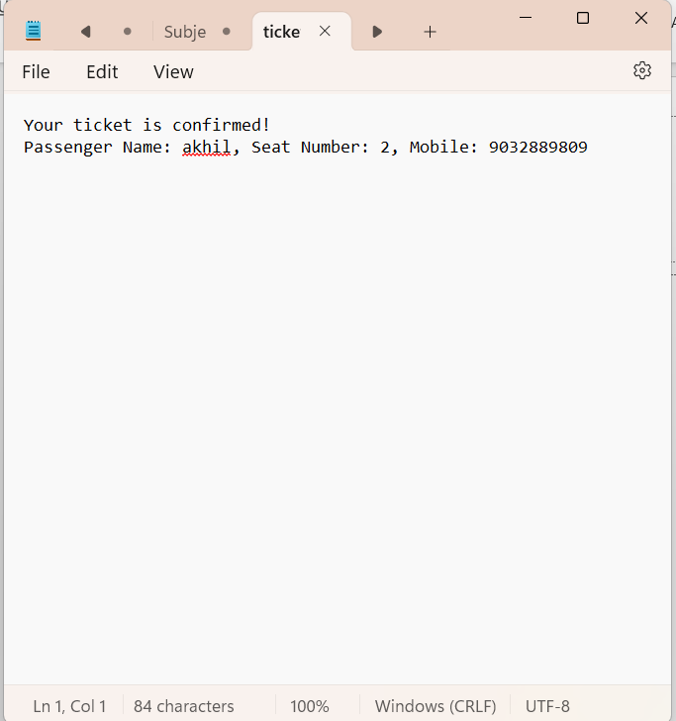
OUTPUT

Slide 15
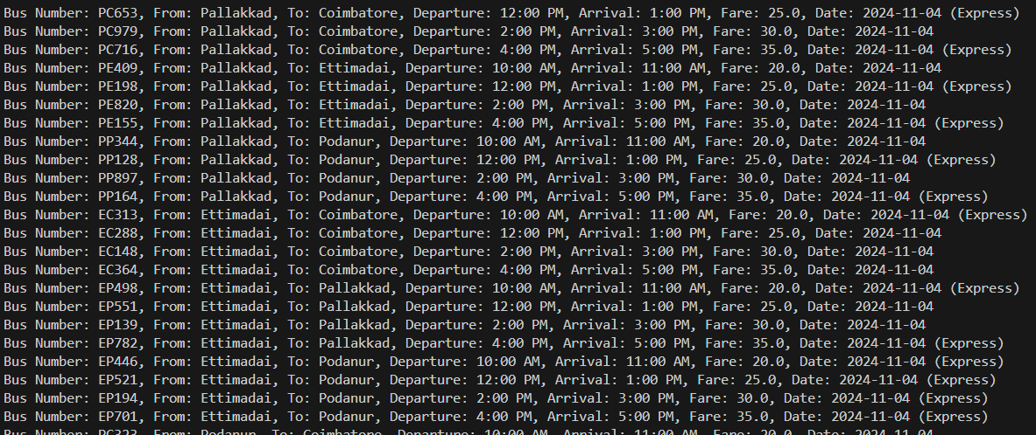
TEST CASE-2

Slide 16
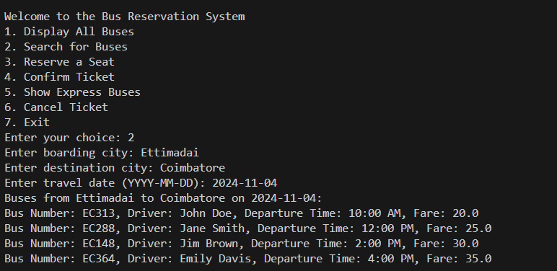

Slide 17
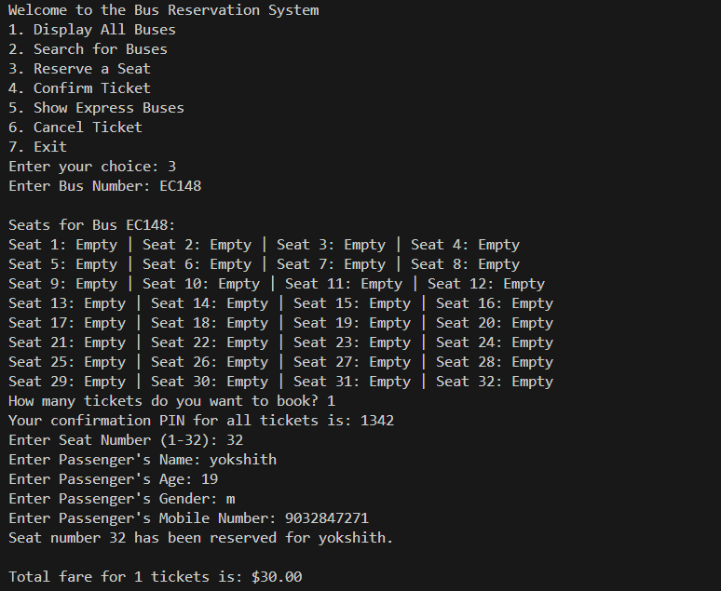

Slide 18
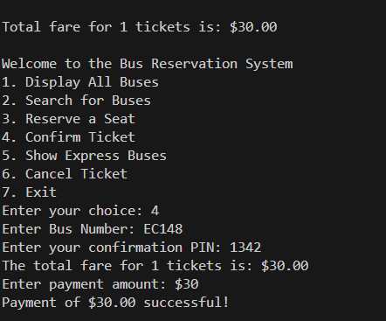

Slide 19
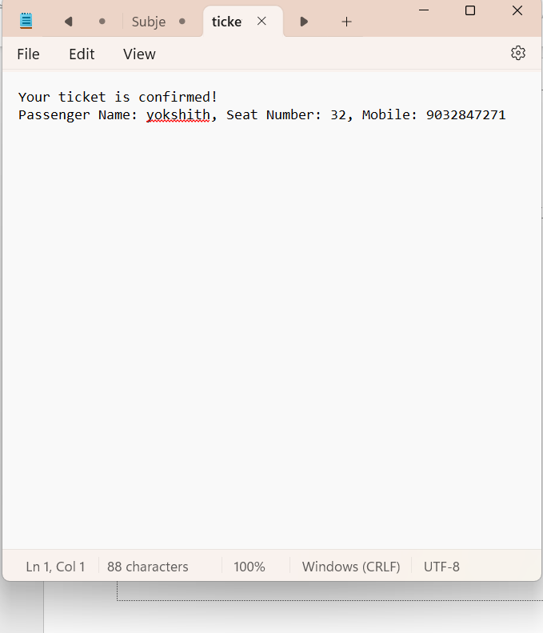
CONFIRMED TICKET

Slide 20
CODE
import random
from collections import deque
from datetime import datetime, timedelta
import os
class BusNode:
def __init__(self, bus):
self.bus = bus # Stores a Bus object
self.next = None
class BusLinkedList:
def __init__(self):
self.head = None
def add_bus(self, bus):
new_node = BusNode(bus)
if not self.head:
self.head = new_node
else:
temp = self.head
while temp.next:
temp = temp.next
temp.next = new_node
def find_bus(self, bus_number):
temp = self.head
while temp:
if temp.bus.bus_number == bus_number:
return temp.bus
temp = temp.next
return None
def search_buses(self, from_city, to_city, travel_date):
temp = self.head
found = False
print(f"Buses from {from_city} to {to_city} on {travel_date}:")
while temp:
bus = temp.bus
if bus.fromCity == from_city and bus.toCity == to_city and bus.date == travel_date:
found = True
print(f"Bus Number: {bus.bus_number}, Driver: {bus.driver_name}, "
f"Departure Time: {bus.departure_time}, Fare: {bus.fare}")
temp = temp.next
if not found:
print("No buses available for the given route and date.")
class Bus:
def __init__(self, bus_number, driver_name, arrival_time, departure_time, from_city, to_city, fare, date, express=False):
self.bus_number = bus_number
self.driver_name = driver_name
self.arrival_time = arrival_time
self.departure_time = departure_time
self.fromCity = from_city
self.toCity = to_city
self.fare = fare
self.date = date
self.express = express # Added express flag
self.seats = [["Empty" for _ in range(4)] for _ in range(8)] # 32 seats
self.reserved_info = [] # To store reserved information
def reserve_seat(self):
self.display_seats() # Show booked and available seats before reserving
try:
number_of_tickets = int(input("How many tickets do you want to book? "))
if number_of_tickets < 1:
print("You must book at least one ticket.")
return
# Generate a single PIN for all tickets
pin = self.generate_pin()
print(f"Your confirmation PIN for all tickets is: {pin}") # Display PIN to user
total_cost = 0 # Variable to accumulate total cost
for _ in range(number_of_tickets):
seat_number = int(input("Enter Seat Number (1-32): "))
if seat_number > 32 or seat_number < 1:
print("\nInvalid Seat Number! There are only 32 seats.")
return
row, col = (seat_number - 1) // 4, (seat_number - 1) % 4
if self.seats[row][col] == "Empty":
passenger_name = input("Enter Passenger's Name: ")
passenger_age = input("Enter Passenger's Age: ")
passenger_gender = input("Enter Passenger's Gender: ")
passenger_mobile = input("Enter Passenger's Mobile Number: ")
# Reserve seat and save passenger information
self.seats[row][col] = "Confirmed" # Show as confirmed
# Save passenger information along with the single PIN
self.reserved_info.append({
"name": passenger_name,
"age": passenger_age,
"gender": passenger_gender,
"mobile": passenger_mobile,
"seat_number": seat_number,
"pin": pin # Use the single PIN for all tickets
})
print(f"Seat number {seat_number} has been reserved for {passenger_name}.")
total_cost += self.fare # Accumulate total fare
else:
print(f"Seat {seat_number} is already reserved. Please select another seat.")
print(f"\nTotal fare for {number_of_tickets} tickets is: ${total_cost:.2f}")
except ValueError:
print("Invalid input. Please enter a valid seat number.")
def display_seats(self):
print(f"\nSeats for Bus {self.bus_number}:")
seat_num = 1
for row in self.seats:
row_display = [] # Create a list to hold seat status for the current row
for seat in row:
status = "Confirmed" if seat != "Empty" else "Empty"
row_display.append(f"Seat {seat_num}: {status}")
seat_num += 1
print(" | ".join(row_display)) # Join the seat statuses with a separator
def generate_pin(self):
"""Generate a four-digit confirmation PIN."""
return random.randint(1000, 9999)
class BusReservationSystem:
def __init__(self):
self.buses = BusLinkedList() # Using linked list to store buses
self.waiting_queue = deque() # Queue for waiting passengers
self.reserved_stack = [] # Stack for recently reserved seats
self.predefined_buses() # Predefined buses when the system initializes
def predefined_buses(self):
"""Add predefined buses for a weekly schedule."""
start_date = datetime.now()
cities = ["Coimbatore", "Pallakkad", "Ettimadai", "Podanur"]
timings = [("10:00 AM", "11:00 AM"), ("12:00 PM", "1:00 PM"), ("2:00 PM", "3:00 PM"), ("4:00 PM", "5:00 PM")]
drivers = ["John Doe", "Jane Smith", "Jim Brown", "Emily Davis"]
fares = [20.0, 25.0, 30.0, 35.0]
for day in range(7): # Weekly schedule
travel_date = (start_date + timedelta(days=day)).strftime('%Y-%m-%d')
for from_city in cities:
for to_city in cities:
if from_city != to_city: # Prevent a bus from going to the same city
for j, (departure_time, arrival_time) in enumerate(timings):
bus_number = f"{from_city[0]}{to_city[0]}{random.randint(100, 999)}"
driver_name = drivers[j % len(drivers)]
fare = fares[j % len(fares)]
# Randomly decide if the bus is express
express = random.choice([True, False])
bus = Bus(bus_number, driver_name, arrival_time, departure_time, from_city, to_city, fare, travel_date, express)
self.buses.add_bus(bus)
def search_buses(self):
from_city = input("Enter boarding city: ")
to_city = input("Enter destination city: ")
travel_date = input("Enter travel date (YYYY-MM-DD): ")
self.buses.search_buses(from_city, to_city, travel_date)
def reserve_seat(self):
bus_number = input("Enter Bus Number: ")
bus = self.buses.find_bus(bus_number)
if bus:
bus.reserve_seat()
self.reserved_stack.append(bus_number) # Track reserved buses in stack
else:
print("Bus not found.")
def confirm_ticket(self):
bus_number = input("Enter Bus Number: ")
bus = self.buses.find_bus(bus_number)
if bus:
pin = int(input("Enter your confirmation PIN: "))
# Collect all reservations for the provided PIN
reservations = [r for r in bus.reserved_info if r['pin'] == pin]
if reservations:
# Calculate total fare
total_fare = len(reservations) * bus.fare
print(f"The total fare for {len(reservations)} tickets is: ${total_fare:.2f}")
payment_amount = float(input("Enter payment amount: $"))
# Simple payment validation
if payment_amount >= total_fare:
print(f"Payment of ${payment_amount:.2f} successful!")
# Write ticket details to a text file
with open("ticket_confirmation.txt", "w") as file:
file.write("Your ticket is confirmed!\n")
for reservation in reservations:
file.write(f"Passenger Name: {reservation['name']}, Seat Number: {reservation['seat_number']}, Mobile: {reservation['mobile']}\n")
# Automatically open the text file
os.startfile("ticket_confirmation.txt")
return
else:
print("Insufficient payment. Tickets cannot be confirmed.")
return
else:
print("Invalid PIN. Please try again.")
else:
print("Bus not found.")
def display_buses(self):
temp = self.buses.head
if not temp:
print("No buses available.")
return
print("\nAvailable Buses:")
while temp:
bus = temp.bus
express_tag = " (Express)" if bus.express else ""
print(f"Bus Number: {bus.bus_number}, From: {bus.fromCity}, To: {bus.toCity}, "
f"Departure: {bus.departure_time}, Arrival: {bus.arrival_time}, Fare: {bus.fare}, "
f"Date: {bus.date}{express_tag}")
temp = temp.next
def show_express_buses(self):
temp = self.buses.head
found = False
print("\nAvailable Express Buses:")
while temp:
bus = temp.bus
if bus.express:
found = True
print(f"Bus Number: {bus.bus_number}, From: {bus.fromCity}, To: {bus.toCity}, "
f"Departure: {bus.departure_time}, Arrival: {bus.arrival_time}, Fare: {bus.fare}, "
f"Date: {bus.date}")
temp = temp.next
if not found:
print("No express buses available.")
def cancel_ticket(self):
bus_number = input("Enter Bus Number: ")
bus = self.buses.find_bus(bus_number)
if bus:
pin = int(input("Enter your confirmation PIN: "))
# Find reservations matching the PIN
cancelled_reservations = [r for r in bus.reserved_info if r['pin'] == pin]
if cancelled_reservations:
for reservation in cancelled_reservations:
seat_number = reservation['seat_number']
row, col = (seat_number - 1) // 4, (seat_number - 1) % 4
bus.seats[row][col] = "Empty" # Mark seat as empty
bus.reserved_info = [r for r in bus.reserved_info if r['pin'] != pin] # Remove from reserved info
print(f"All reservations with PIN {pin} have been cancelled.")
else:
print("Invalid PIN. No matching reservations found.")
else:
print("Bus not found.")
def main():
system = BusReservationSystem()
while True:
print("\nWelcome to the Bus Reservation System")
print("1. Display All Buses")
print("2. Search for Buses")
print("3. Reserve a Seat")
print("4. Confirm Ticket")
print("5. Show Express Buses")
print("6. Cancel Ticket")
print("7. Exit")
choice = input("Enter your choice: ")
if choice == '1':
system.display_buses()
elif choice == '2':
system.search_buses()
elif choice == '3':
system.reserve_seat()
elif choice == '4':
system.confirm_ticket()
elif choice == '5':
system.show_express_buses()
elif choice == '6':
system.cancel_ticket()
elif choice == '7':
print("Thank you for using the Bus Reservation System. Goodbye!")
break
else:
print("Invalid choice. Please try again.")
if __name__ == "__main__":
main()

Slide 21
THANK YOU

